Slide 1
Fast RCNN and Faster R-CNN
Presented : Muhammad Zaqeem

Slide 2
Overview
Problem With R-CNN
Fast R-CNN
How Fast R-CNN Works
Faster R-CNN
How Faster R-CNN Works
Comparsion of R-CNN, Fast R-CNN and Faster R-CNN

Slide 3
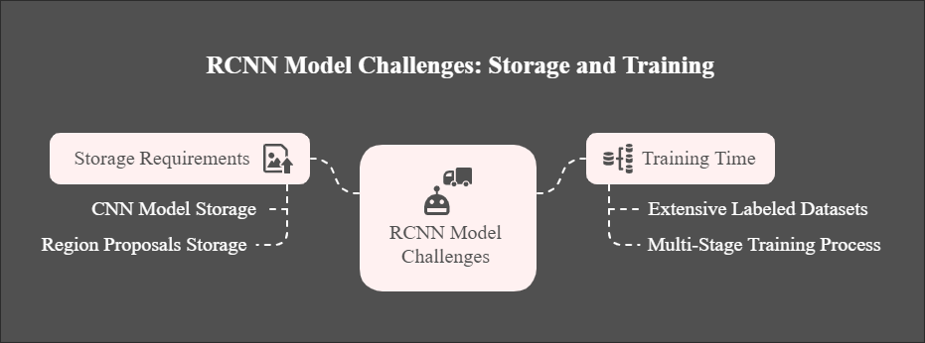
Problems with R-CNN
This diagram highlights the major bottlenecks in RCNN, including high memory usage and long training times, which led to the development of faster models like Fast RCNN and Faster RCNN.

Slide 4


Slide 5
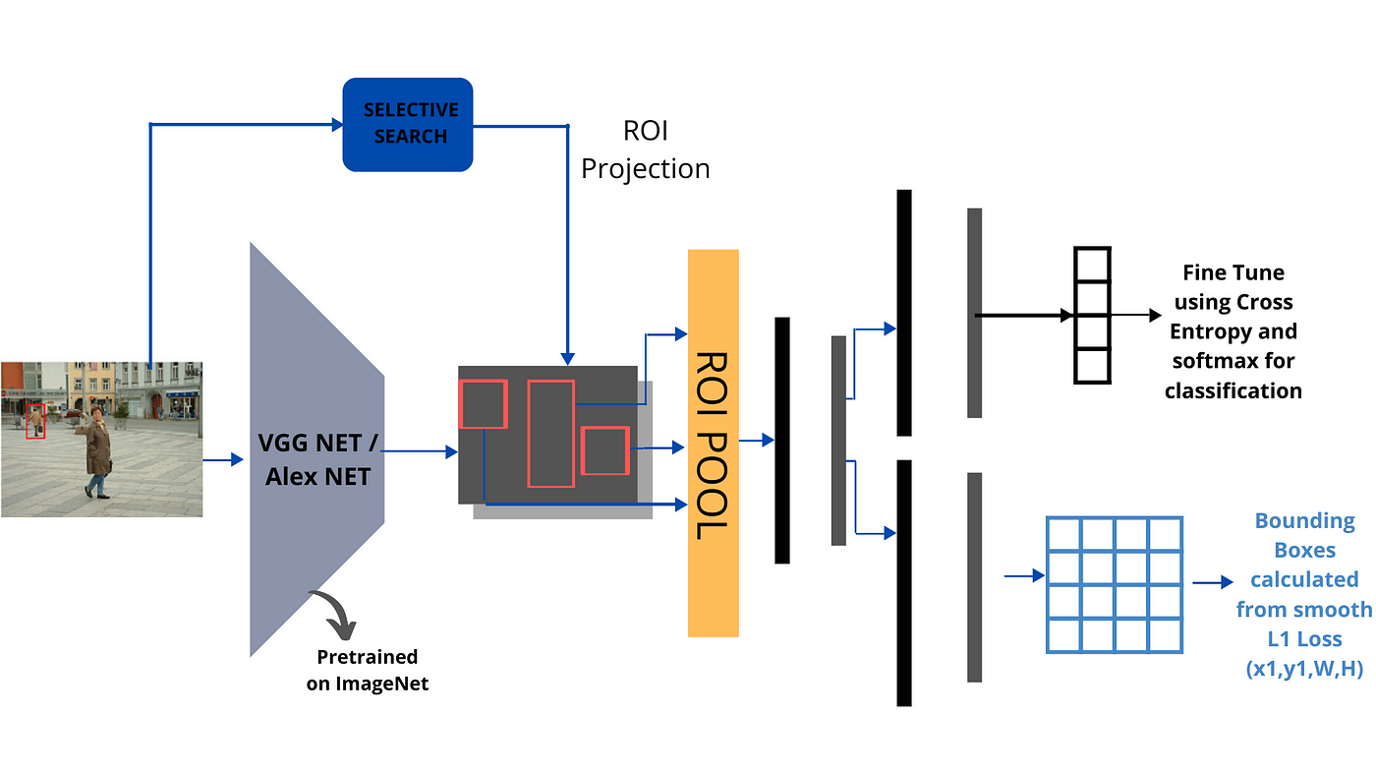

Fast R-CNN
The image illustrates the Fast R-CNN pipeline. Instead of processing each region separately like R-CNN, the entire image is passed through a pretrained CNN (VGGNet/AlexNet) to extract a feature map. Selective Search then proposes regions, which are mapped onto the feature map
Fast R-CNN was introduced by Ross Girshick in 2015 as an improvement over R-CNN.
It significantly increased the speed of object detection
The entire input image is fed into a Convolutional Neural Network (CNN) (such as VGG16 or ResNet).
This CNN extracts feature maps from the whole image instead of processing each region separately.

Slide 6
How Fast R-CNN Works:
Image Processing with a CNN Backbone:
The entire input image is fed into a Convolutional Neural Network (CNN) (such as VGG16 or ResNet).
This CNN extracts feature maps from the whole image instead of processing each region separately.
Region Proposal via Selective Search:
A separate region proposal method (e.g., Selective Search) identifies N region proposals (bounding boxes).
These proposals are mapped onto the extracted feature map, rather than being processed separately.
ROI Pooling (Region of Interest Pooling):
ROI pooling ensures all proposals have a fixed-size output (e.g., 7×7×512) regardless of the original proposal size.

Slide 7
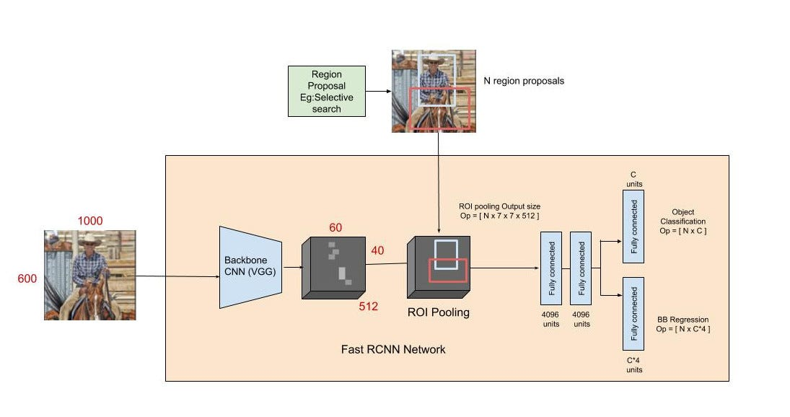
How Fast R-CNN Works:
Fully Connected Layers:
The pooled features go through fully connected layers (like in traditional CNNs).
Two outputs are generated:
Object Classification: Determines the object category (e.g., car, dog, person).
Bounding Box Regression: Refines the coordinates of the detected objects for better localization.
The Fast R-CNN architecture processes an input image using a CNN backbone (e.g., VGG) to extract feature maps. Region proposals are mapped onto these feature maps and standardized via ROI Pooling. The pooled features pass through fully connected layers, enabling object classification and bounding box regression for accurate localization.

Slide 8
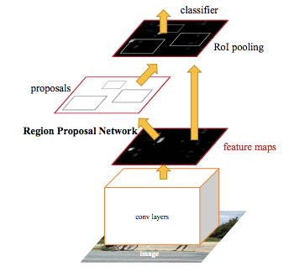
Faster R-CNN
Faster R-CNN (Faster Region-Based Convolutional Neural Network) is a leading object detection model introduced in 2015 by Ren, He, Girshick, and Sun.
Designed to identify and accurately locate objects within an image.
Integrates deep learning, CNNs, and Region Proposal Networks (RPNs) into a unified framework.
Significantly improves speed and accuracy over previous R-CNN models.
The image depicts the Faster R-CNN pipeline. An input image passes through CNN layers to extract feature maps. The Region Proposal Network (RPN) generates object proposals, which are refined through RoI pooling and classified to detect objects accurately.

Slide 9
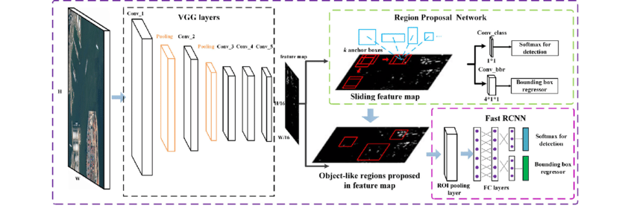
How Faster R-CNN Works
Region Proposal Network (RPN)
A CNN backbone extracts feature maps from the input image.
Anchors (predefined boxes) predict potential object locations.
The RPN classifies anchors as object or background and refines box positions.
Object Detection & Refinement
RoI Pooling resizes proposals to a fixed size.
The resized RoIs are passed through fully connected layers for Classification and Bonding Box regression.
The CNN backbone (VGG) extracts feature maps from the input image. Next, the Region Proposal Network (RPN) uses sliding windows and predefined anchors to generate potential object regions, classifying them as object or background and refining their positions. The proposed regions are resized using RoI pooling and passed through fully connected layers in the Fast R-CNN module. This module performs classification to assign object labels and bounding box regression to refine object boundaries, producing the final detection results.

Slide 10
Comparison of R-CNN , Fast R-CNN , Faster R-CNN
Feature | R-CNN | Fast R-CNN | Faster R-CNN
Test Time (per image) | 48 seconds | 1 second | 0.1 seconds
Speedup | 1x | 25x | 250x
mAP (VOC 2007) | 58.5 | 66.9 | 73.2
Region Proposal Method | Selective Search | Selective Search | Region Proposal Network (RPN)
Feature Extraction | CNN (per region) | CNN (shared) + RoI Pooling | CNN (shared) + RoI Pooling
Classification | SVM | Softmax (Fully Connected Layers) | Softmax (Fully Connected Layers)

Slide 11

Thank You

